Slide 1

School of Geography and Geology
McMaster University
WELCOME TO
GEO 4GA3
Applied Spatial Statistics

Slide 2
Applied Spatial Statistics
Geographical Information Systems
Follow up to 3MB3: Statistical Analysis
  Emphasis on spatial data and spatial effects

Slide 3
Instructors
Antonio Páez
Patrick De Luca
Course structure
  Lectures
  Labs

Slide 4
Course Outline
Course objectives

Slide 5
Course Outline
Evaluation

Slide 6
Course Guidelines and Regulations
Contacting the instructor
  Office hours
  E-mail to set an appointment

Slide 7
Course Guidelines and Regulations
Mark appeals:
  Appeal directly to the person who marked your work
  Appeals in writing: 24 hours rule (Within 15 days of receiving the work back)
  Re-marking may result in a higher or lower grade!

Slide 8
Course Guidelines and Regulations
Students with special needs

Slide 9
Course Guidelines and Regulations
Missed work

Slide 10
Term Project
Projects
  In teams of 3
  Topics: to be selected by students
  Formation of teams: suggest that students with similar interests/area of study work together
  You will need to find your own dataset

Slide 11
Term Project
Components
  Group Work Contracts
    Friday January 20th @ 4:30 PM in drop box
  Literature Review (5%)
    Friday February 10th @ 4:30PM in drop box
    5 pages maximum (not including references)
    Use same style notes as for labs

Slide 12
Term Project
Components
  Project Paper (15%)
    Friday March 24th @ 4:30PM in drop box
    Proper report format: Intro, Data and Study Area, Methods, Results and Discussion, Conclusion, References
    Style and Grammar, Extra Efforts
  Final Presentation – See outline for due date (10%)
    You are required to use presentation software
    Each group member required to speak
    Purpose is to present the full findings of the project including recommendation
    5% for presentation, 5% for participation

Slide 13
Group Work Contracts (1)
Helps resolve group conflicts by setting acceptable standards that are mutually agreeable
  Names and contact info for all members
  Proposed topic area (area of common interest)
  Guidelines for scheduling group meetings
  Guidelines for conduct as a member of the group
  Conflict resolution scheme
  Peer-evaluation mechanism
  Signatures of all group members

Slide 14
Group Work Contracts (2)
Past sources of conflict
  Work Scope
  Resources
  Scheduling
  Priorities
  Organizational Issues
  Personal Differences

Slide 15
Lectures and other events
Tentative schedule (see outline)

Slide 16



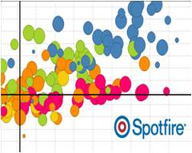
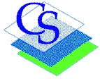
THE GIS LABS: BSB 331 & 332

Slide 17
About the Lab & GIS @ Mac
One of 27 Esri Development Centres (3 in Canada)
One of 10 Centres of Excellence for GIS across Canada
  ECCE Events this term
    ESRI Young Scholar (national winner)
    ECCE Student of the Year award (within McMaster)
    EDC Student of the Year award (within McMaster)
    2017 App Challenges
      ECCE App Challenge in March (open only to invited students)
      International Year of Global Understanding Story Maps Competition
    ESRI Scholarship (Final Date for Submissions is March 17)
      http://sciwebserver.science.mcmaster.ca/gislab/scholarship.html

Slide 18
About the Lab
Updated GIS Lab information can be found on the GIS Bulletin Board outside the labs
  Up-to-date information about the Labs
  GIS in the News
  Program information
  Employment Opportunities (including internships)

Slide 19
About the Lab
Current Hardware Environment
  Windows 2012 R2 Server
  50 Windows 7 x64 Clients
Primary Software used this term
  Full ArcGIS 10.4.1 Suite
  S+ 8.2, GeoDA, CrimeStat, R (if you want)
  OpenOffice

Slide 20
Lab Software and Ownership Policies
Academic Site License for ArcGIS 10.4.1
  You retain rights to your original work, but once course is done you have no rights to access the software in any lab, you must obtain additional permissions
  Can purchase a student version of ArcGIS 10.4.1 for $30 (good for 1 year from activation date)
    If interested, please download form from Avenue, fill it out and bring to Pat in BSB 331A
Much of the data used is proprietary, you cannot use it when course is completed
  In no event will McMaster University be responsible for the use by a student of any data for which appropriate permission was not obtained.

Slide 21

Lab Policies (1)
NO FOOD OR DRINK ALLOWED
NO EXCEPTIONS AND IT WILL BE POLICED

Slide 22
Lab Policies (2)
FOR ACADEMIC USE ONLY!
Primarily for: 3GV3, 3SR3, 4GA3
User Accounts are your own, please don’t share them
Disk Storage is not provided, please use a USB drive
Please be aware that PCs in the labs will be re-formatted at least once a month but may be more often depending on security or performance software patches

Slide 23
Lab Policies (3)
Reporting bugs with software/hardware
  Please email any issues to Patrick DeLuca
  delucapf@mcmaster.ca
Student access is available as long as the building is open.
Login ID/Password
Change password immediately upon first logon
Room maintenance
  Please keep the lab clean, remember you are on camera!

Slide 24
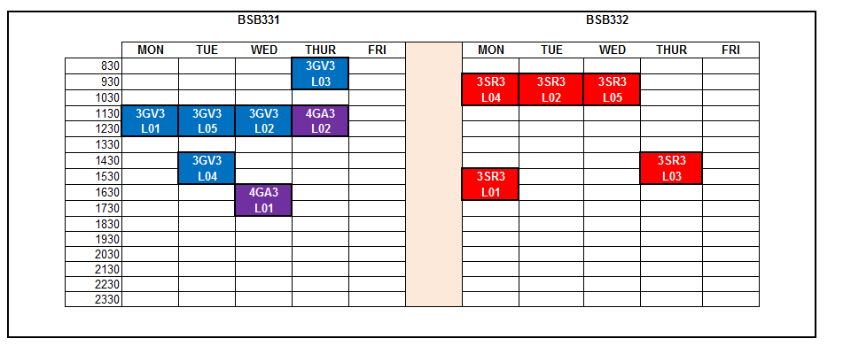
Lab Schedule
Door Code: 3412

Slide 25
Course Description
Intermediate methods of spatial analysis
Course contents

Slide 26
Potential of Spatial Data
Formally test hypotheses through statistical methods
  Scientific method
Estimate extent and form of relationships
Usually proceeds by identifying any heterogeneities in mean value and then modeling residuals or deviations from this trend.

Slide 27
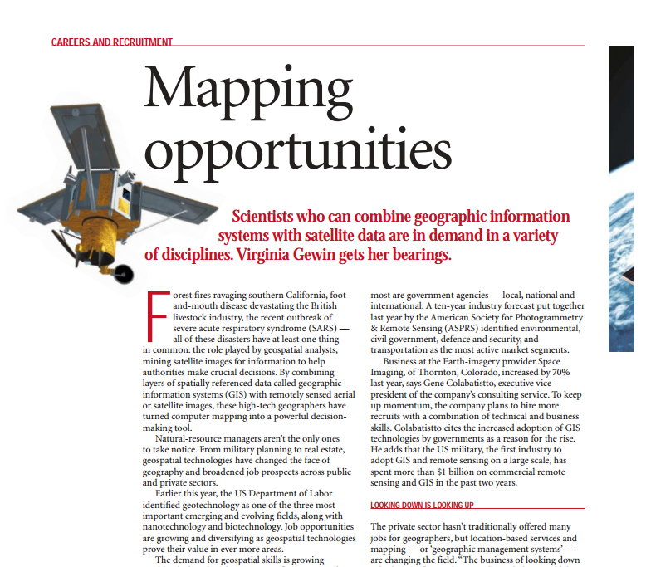
Career potential
Nature, 2004
Nanotechnologies, biotechnologies
Geospatial

Slide 28
Career potential
Fastest growing jobs:
#5 Statistician
#15 Cartographer
http://www.forbes.com/pictures/fihh45hmgl/introduction/#61648d06e266

Slide 29
Career potential
Skills in demand in 2017
#2 Statistical analysis and data mining
Also:
  #1 Cloud and distributed computing
  #7 Mobile development
http://www.businessinsider.com/skills-that-can-get-you-hired-2016-10

